Slide 1
复利和退休计划管理
(401K, 403b, 457 plans)
李春贵

Slide 2


Slide 3
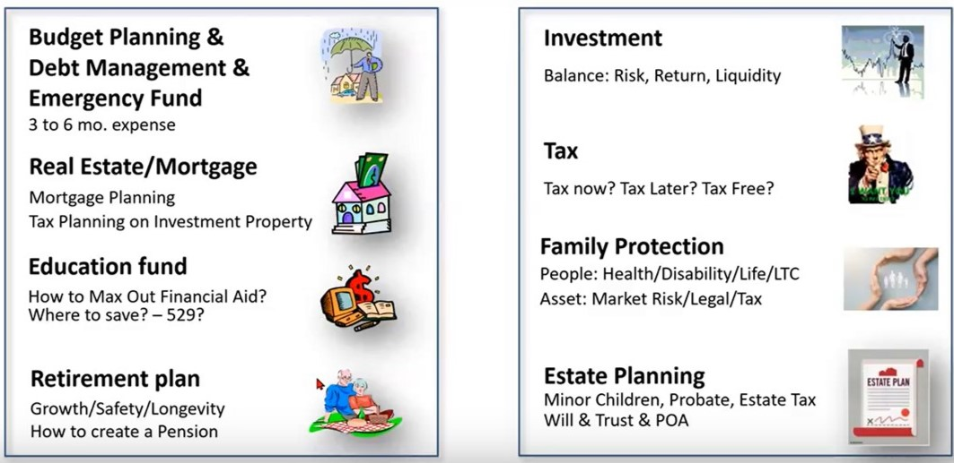
财务规划和金融投资及管理的八个方面

Slide 4
金融投资需要关注的要点
投资回报Market Return
市场风险Market Risk
投资税务责任Investment Tax
灵活性Flexibility
流动性Liquidity
投资者行为和纪律性Investor Behavior and discipline

Slide 5
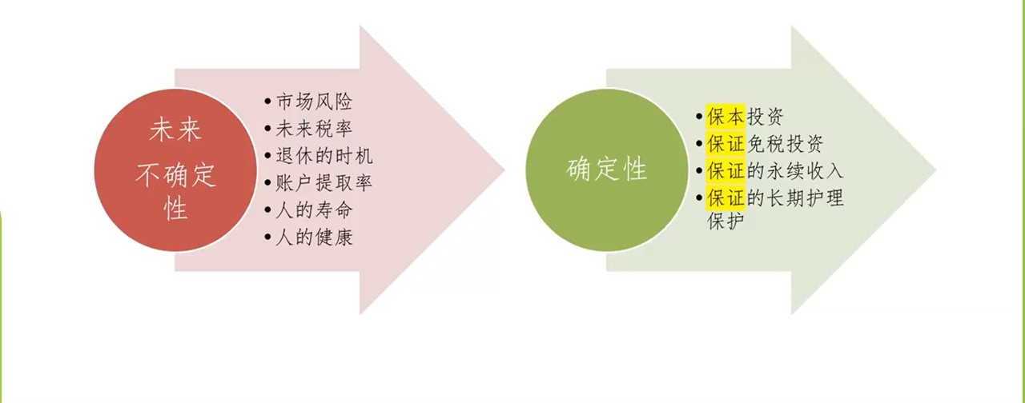
规律
金融规划的目的： 不确定性 --------> 确定性

Slide 6
我们推荐的理念和原则
We encourage each family and every individual to have a financial plan in day one, encourage each family to review and update this financial plan in each of the family’s milestones. We emphasize creating a disciplined and active (in opposite to inactive or reactive) financial plan with sound, solid, effective processes for all 8 sectors.
我们鼓励每一个家庭每一位朋友都在你开始工作学习的第一天, 就建立一个金融计划， 鼓励在人生中每一个里程碑重新评价和更新这个金融计划。我们着重于鼓励需要的朋友们建立一个有纪律性的积极的（反对消极的或者反应性）的金融计划。在这个计划中我们可以帮助在八大块儿中的每一块都建立强有力的，实实在在的，有效的行事规则和方法来有效地管理个人和家庭的财务。

Slide 7
退休计划的五个投资基本法则
早投 （Invest earlier）
分散 （Diversification）
定投 （Dollar cost averaging)
长期 （Time in the market not timing the market）
保本 （Downside protection）

Slide 8
投资基本法则 – 早投 赶早不赶晚
Interest Problems are word problems that use formula for calculating Interests as well as future values:
Simple Interest and future value
Compound Interest and future value
Continuously Compounded Interest and future value

Slide 9
In Finance, compounding is the process by which an asset's earnings, from either capital gains or interest, are reinvested to generate additional earnings over time.

Slide 10
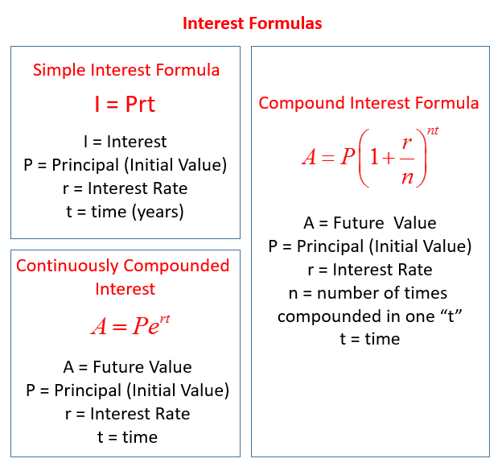

Slide 11
Simple interest is applied only to the principal and not any accumulated interest.
Compound interest is interest accruing on the principal and previously applied interest.
The effect of compound interest depends on how frequently it is applied.
For bonds, the bond equivalent yield is the expected annual return.
Continuously compounding returns scale over multiple periods.
Interest compounding at its highest frequency is said to be compounding continuously.

Slide 12
Simple Interest and Future Value

Slide 13
Simple Interest Problem Example:
John wants to have an interest income of $3,000 a year. How much must he invest for one year at 8%?

Slide 14
Simple Interest Problem Example:
John wants to have an interest income of $3,000 a year. How much must he invest for one year at 8%?
Step 1: Write down the formula I = prt
Step 2: Plug in the values 3000 = p × 0.08 × 1 3000 = 0.08p p = 37,500
Answer: He must invest $37,500

Slide 15
Compound Interest and Future Value

Slide 16
Current Deposit Rates for 08/26/2023 - 09/01/2023
Savings Accounts:
Annual Percentage Yields (APYs) and Interest Rates shown are offered on accounts accepted by the Bank and effective for the dates shown above, unless otherwise noted. Interest Rates are subject to change without notice. Interest is compounded daily and paid monthly. Interest is calculated and accrued daily based on the daily collected balances in the account. Accrued interest is considered to be earned and will be paid only when the total interest accrued reaches $0.01 or more.
From https://www.wellsfargo.com/savings-cds/rates/

Slide 17
Compound Interest Problem Example:
Scott wants to invest $1000 for 1 year. At Bank A, his investment will collect 3% interest compounded daily while at Bank B, his investment will collect 3.50% interest compounded monthly. Which bank offers a better return? How much more will he receive by choosing that bank over the other?

Slide 18
Compound Interest Problem Example:
Scott wants to invest $1000 for 1 year. At Bank A, his investment will collect 3% interest compounded daily while at Bank B, his investment will collect 3.50% interest compounded monthly. Which bank offers a better return? How much more will he receive by choosing that bank over the other?
Bank B, $5.12

Slide 19
The inventor of chess (in some tellings Sessa, an ancient Indian Minister, year 1256) request his ruler give him wheat according to the wheat and chessboard problem. The ruler laughs it off as a meager prize for a brilliant invention, only to have court treasurers report the unexpectedly huge number of wheat grains would outstrip the ruler's resources.

Slide 20
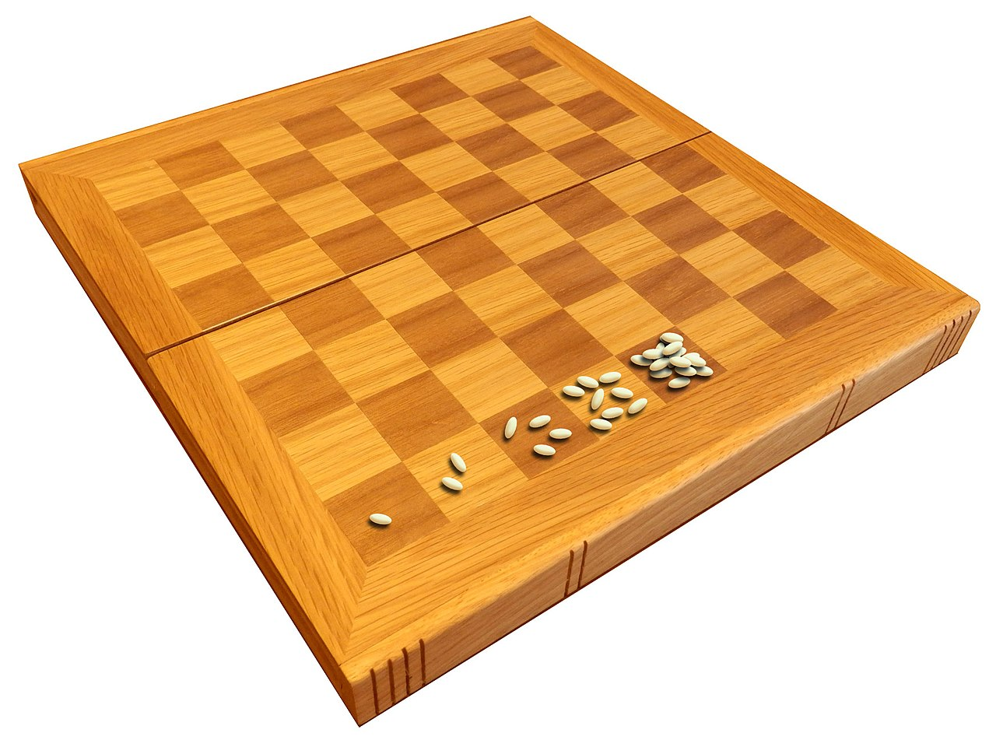
The Wheat and Chess Board Story
投资基本法则 – 早投 赶早不赶晚
The last grid alone holds 461 Billion Tons of wheat, which is over 590x world production
1 2 4 8 16 …
2⁰ 2¹ 2² 2³ 2⁴ …

Slide 21
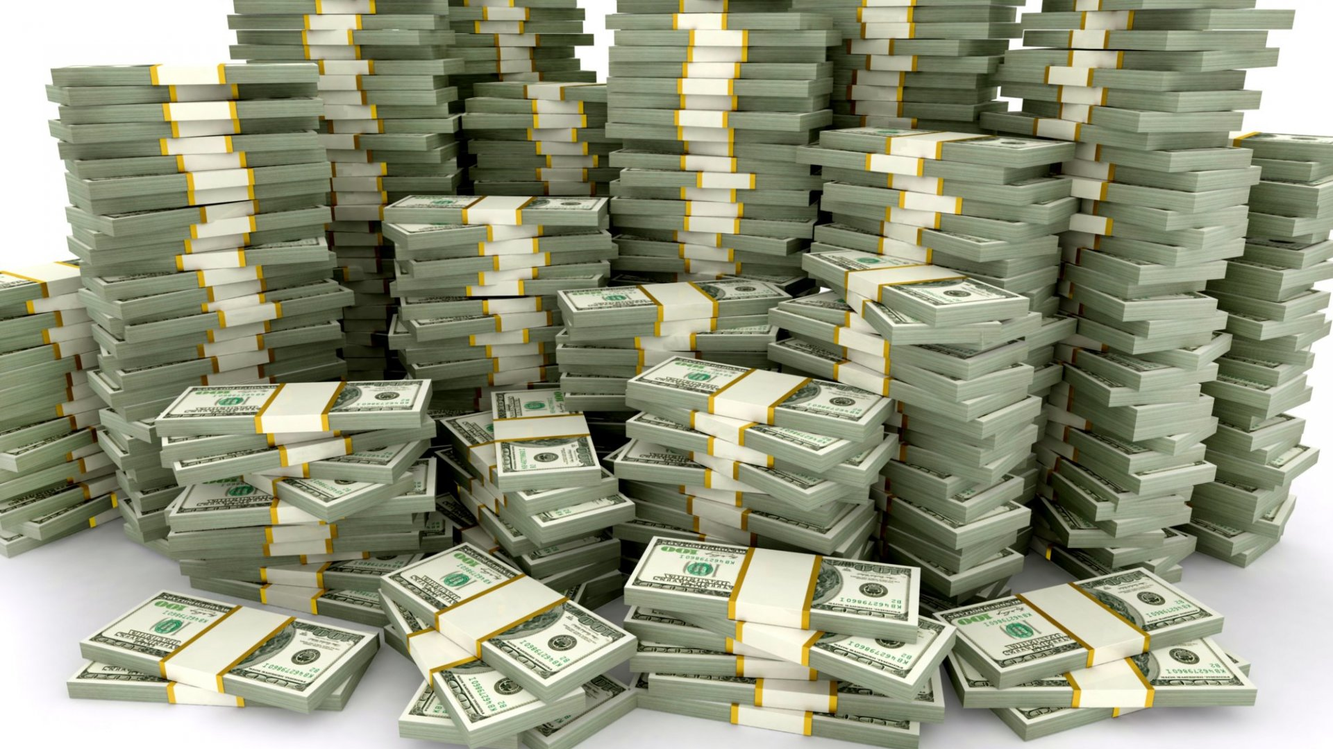
Would you rather have a million dollars or a penny on day 1, doubled every day until day 30?
2³⁰−1=1,073,741,823 Cents
Or: over 10 million dollars

Slide 22

Day 0
2⁰

Slide 23

Day 1
2¹

Slide 24

Day 2
2²

Slide 25

Day 3
2³

Slide 26

Day 4
2⁴

Slide 27

Day 5
2⁵

Slide 28

Day 6
2⁶

Slide 29

Day 7
2⁷

Slide 30

Day 8
2⁸

Slide 31

Day 9
2⁹

Slide 32

Day 10
2¹⁰

Slide 33

Day 11
2¹¹

Slide 34

Day 11.3
2^{11.3}

Slide 35





What does a fish feel in the pond?
The fish is totally happy: < 25% covered
Slightly concerned: > 25% covered
Seriously concerned: > 50% covered
Dead 100% covered
Day 1 | Day 2 | Day 3 | Day 4 | Day 5 | Day 6 | Day 7 | Day 8 | Day 9 | Day 10 | Day 11 | Day 11 7 AM

Slide 36

An example of compounding working against us: COVID-19

Slide 37
Exercise: Folding papers
The thickness of a standard printing paper is about 0.1mm. Fold it once and it will be 0.2mm thick. If fold it again, it will be 0.4mm thick. Keeping folding it:
Times of Folding | The thickness of the Folded Paper
0
1
2
7
14
21
42
50

Slide 38
Exercise: Folding papers
The thickness of a standard printing paper is about 0.1mm. Fold it once and it will be 0.2mm thick. If fold it again, it will be 0.4mm thick. Keeping folding it:
Times of Folding | The thickness of the Folded Paper | 2^{x}
0 | 0.1mm | 0.1 x 2⁰
1 | 0.2mm | 0.1 x 2¹
2 | 0.4mm | 0.1 x 2²
7 | 128mm | 0.1 x 2⁷
14 | 1638.4mm = 1.63m | 0.1 x 2¹⁴
21 | 209715.2mm = 2,097m | 0.1 x 2²¹
42 | 4.4 x 10¹⁰m | 0.1 x 2⁴²
50 | 1.1 x 10¹³m | 0.1 x 2⁵⁰

Slide 39
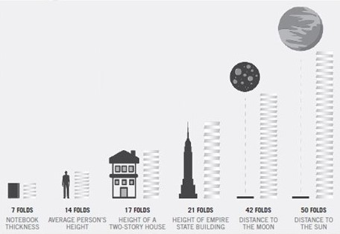

Slide 40
Exercise:
Calculate $1’s worth at age 65 if investing the $1 at ages 20, 25, 30, 35, 40, 45, 50, 55

Slide 41
Starting Age of the $1 Investment | Ending Age of the $1 Investment | The Worth of $1 Investment At Ending Age
20 | 65
25 | 65
30 | 65
35 | 65
40 | 65
45 | 65
50 | 65
55 | 65

Slide 42
Starting Age of the $1 Investment | Ending Age of the $1 Investment | The Worth of $1 Investment At Ending Age
20 | 65 | $13.76
25 | 65 | $10.29
30 | 65 | $7.69
35 | 65 | $5.74
40 | 65 | $4.29
45 | 65 | $3.21
50 | 65 | $2.40
55 | 65 | $1.79

Slide 43
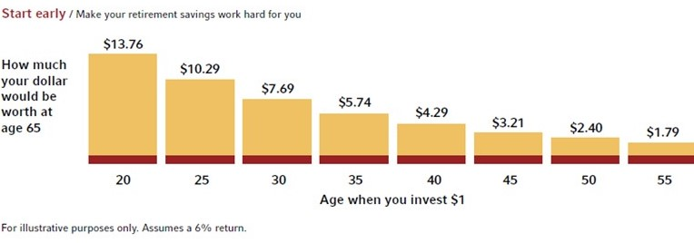

Slide 44
Have you started saving or investing?

Slide 45
Compounding Problem:
John invested $2,000 each year from year 2011 for first 8 years of a 40-year period with an annual compound rate of 10%. Kevin started to invest $2,000 a year from 2019 with the same rate and he has planned to continue to do that until 2050. Who will earn more by the end of year 2050? By how much?

Slide 46
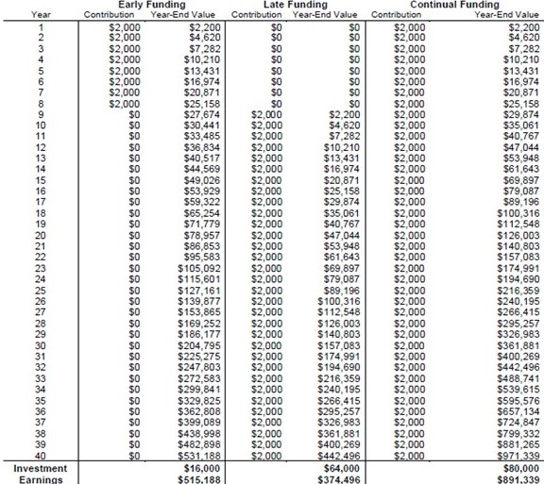

Slide 47
When to start investing matters!!!
纯利润
第一个十年：
$1,295,291
第二个十年：
$425,656
第三个十年：
$90,374
Assumptions: Same annual return of 10% (not guaranteed)

Slide 48
My wealth has come from a combination of living in America, some lucky genes, and compound interest.
Warren Buffett – The Giving Pledge, 2010. www.givingpledge.org

Slide 49
The amount of initial investment matters!!!
Accounts allowing only low annual contributions
Only saving low amount yearly
Accounts allowing only high annual contributions
Saving in higher amount yearly
Assumptions: Same total principle $120K, Same annual return of 10% (not guaranteed)

Slide 50
With compounding, how many years would it take for your money to double?

Slide 51
Rule of 72
Divide 72 by the interest rate to estimate the number of years it takes for your money to double.
Age
29
47
65
4%
$10,000
$20,000
$40,000
Age
29
41
53
65
6%
$10,000
$20,000
$40,000
$80,000
Age
29
38
47
56
65
8%
$10,000
$20,000
$40,000
$80,000
$160,000
Age
29
35
41
47
53
59
65
12%
$10,000
$20,000
$40,000
$80,000
$160,000
$320,000
$640,000
* All figures are for illustrative purposes only and do not reflect an actual investment in any product. They do not reflect the performance risks, expenses or charges associated with any actual investment. Past performance is not an indication of future performance. The Rule of 72 is a mathematical concept that approximates the number of years it would take to double the principal at a constant rate of return. The performance of investments fluctuates over time, and as a result, the actual time it will take an investment to double in value cannot be predicted with any certainty. Additionally, there are no guarantees that any investment or savings program can out-pace inflation.

Slide 52
Rule of 72
Divide 72 by the interest rate to estimate the number of years it takes for your money to double.
Age
29
47
65
4%
$10,000
$20,000
$40,000
Age
29
41
53
65
6%
$10,000
$20,000
$40,000
$80,000
Age
29
38
47
56
65
8%
$10,000
$20,000
$40,000
$80,000
$160,000
Age
29
35
41
47
53
59
65
12%
$10,000
$20,000
$40,000
$80,000
$160,000
$320,000
$640,000
* All figures are for illustrative purposes only and do not reflect an actual investment in any product. They do not reflect the performance risks, expenses or charges associated with any actual investment. Past performance is not an indication of future performance. The Rule of 72 is a mathematical concept that approximates the number of years it would take to double the principal at a constant rate of return. The performance of investments fluctuates over time, and as a result, the actual time it will take an investment to double in value cannot be predicted with any certainty. Additionally, there are no guarantees that any investment or savings program can out-pace inflation.

Slide 53
“The Rule of 72”:
Simply assume a reasonable rate of return for planning purposes (between 7 percent and 9 percent over a multidecade time period) and divide 72 by that rate. This calculates the period of time it would take for your money to double.
Note: The Rule of 72 is an approximation. The equation is 2 = 1 × (1 + Rate of Return)^{Y}, where Y is the time to double.

Slide 54
$40,000
$30,000
$20,000
$10,000
2 3 4 5 6 7 8 9 10 11 12 13 14 15 16 17 18
Years
Cumulative Compound Interest
Initial Investment
GROWTH OF $10,000 INVESTMENT WITH AN 8 PERCENT RETURN: IN I T I A L INVESTMENT VERSUS CUMULATI V E COMPOUND I NTEREST

Slide 55
Warren Buffett says, “Life is like a snowball. The important thing is finding wet snow and a long hill”:
The wet snow is the interest you reinvest to pick up even more interest as you roll along.
The long hill is the multiple decades you give yourself if you start saving early.

Slide 56
The formula for compound interest is:
A = P (1 + r/n) ^{nt}
Where:
A = the future value of the investment/loan, including interest
P = the principal investment amount (the initial deposit or loan amount)
r = the annual interest rate or return
n = the number of times that interest is compounded per unit t
t = the time the money is invested or borrowed for

Slide 57

Compounding Summary
T, when to invest matters.
P, the amount of initial investment matters.
R, the interest or return rate matters.

Slide 58
Compounding Summary
It could be your BEST friend (wealth/business)
It could be your WORST enemy (tax/COVID)
Compounding Power comes at late stage
How to manage life/study/investment?
Understand its power and make use of it
Success is not far away

Slide 59
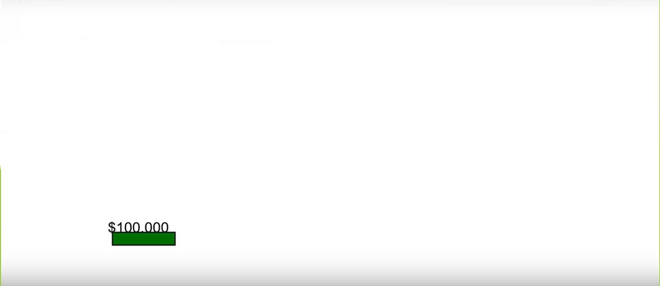
投资基本法则 – 分散

Slide 60
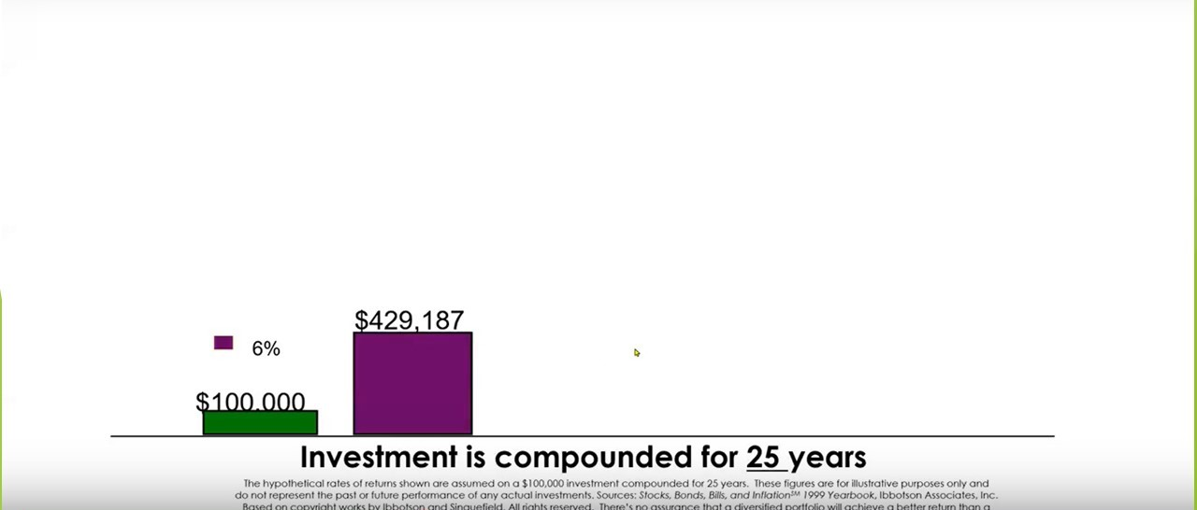
投资基本法则 – 分散

Slide 61
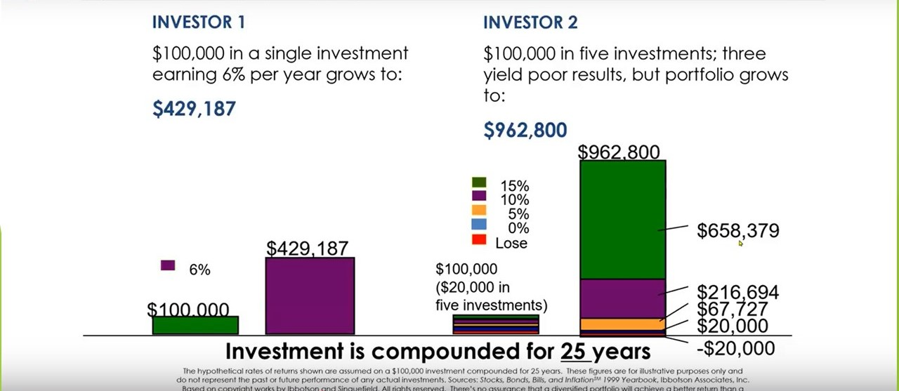
投资基本法则 – 分散

Slide 62
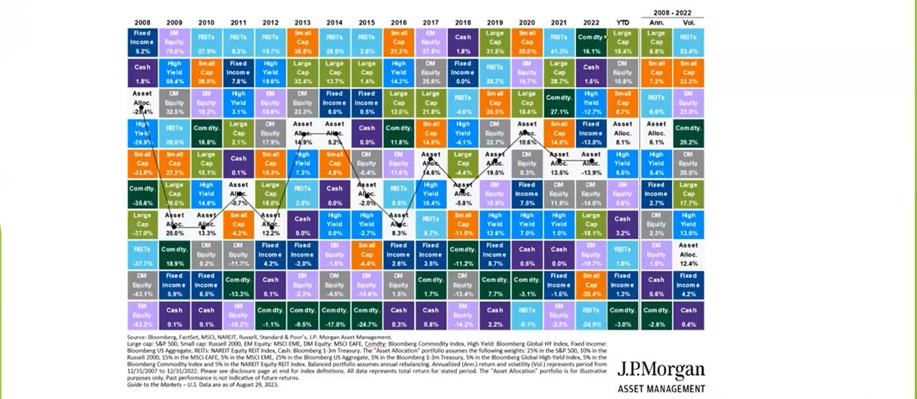
资产种类分散

Slide 63
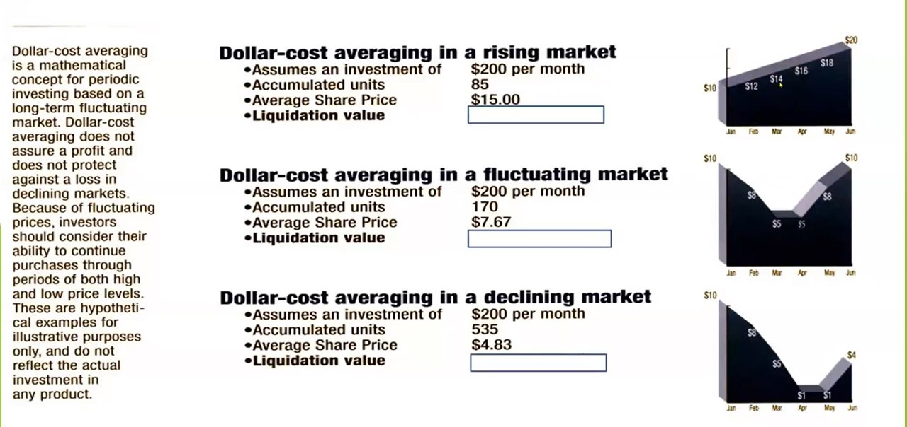
投资基本法则 – 定投

Slide 64
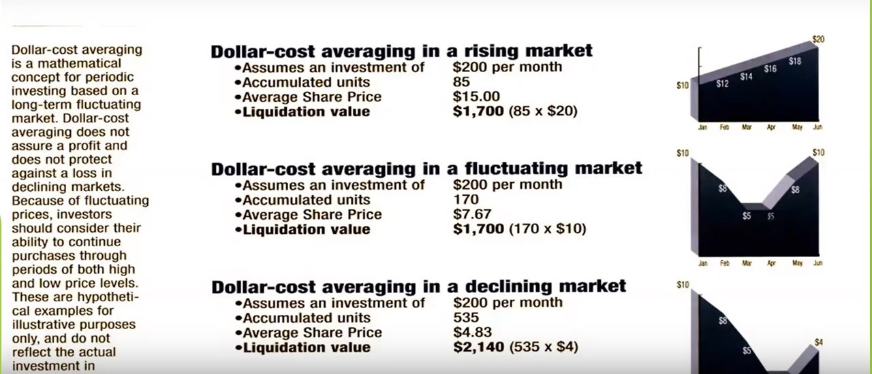
投资基本法则 – 定投

Slide 65
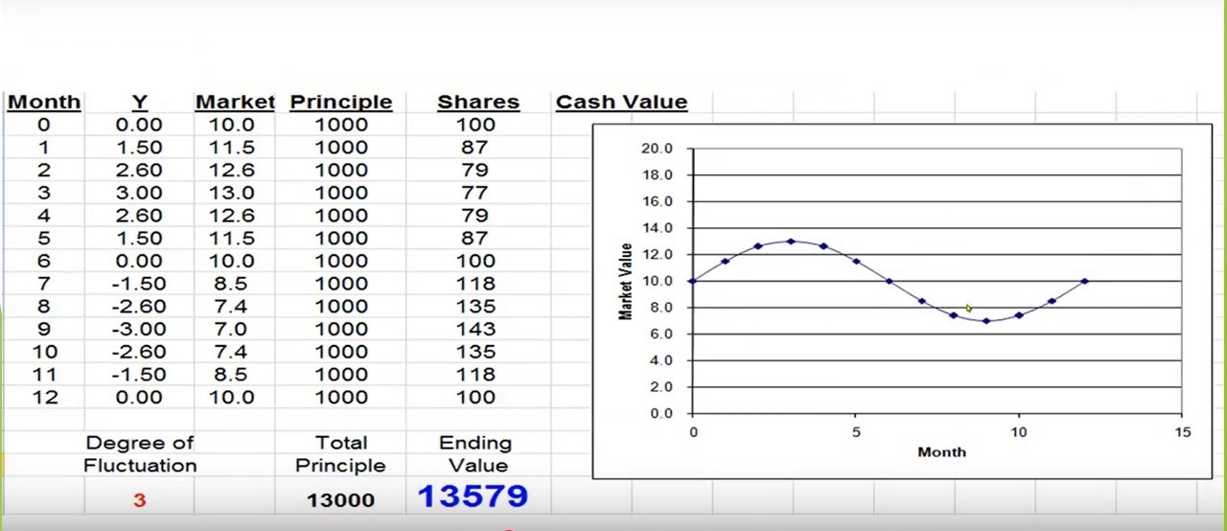
投资基本法则 – 定投

Slide 66
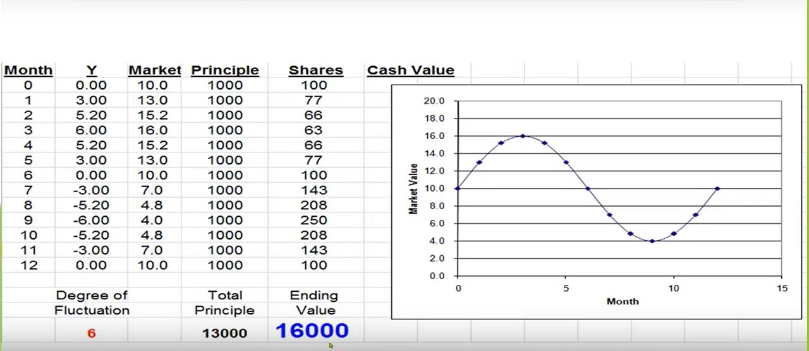
投资基本法则 – 定投

Slide 67
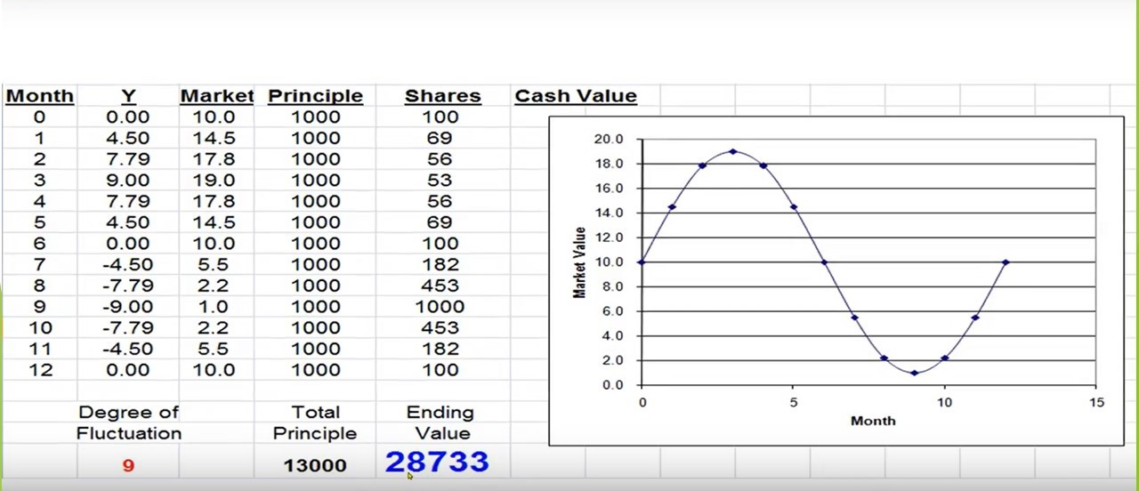
投资基本法则 – 定投

Slide 68
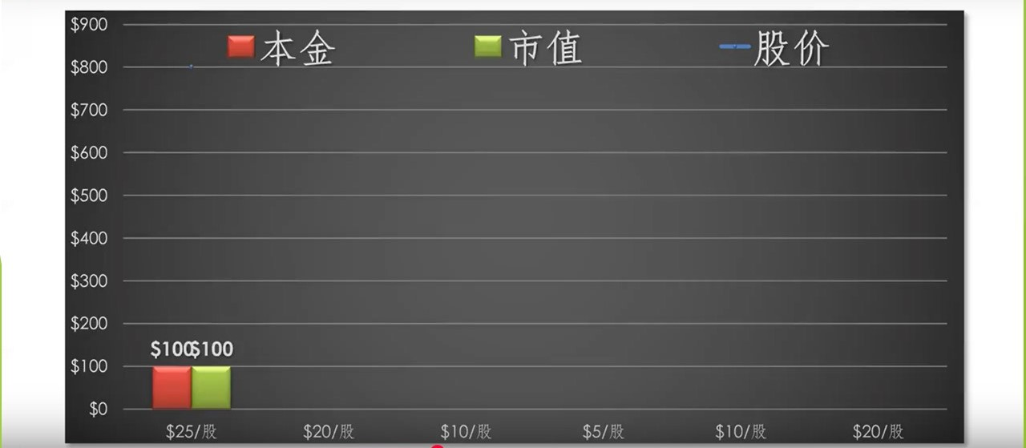
投资基本法则 – 定投

Slide 69
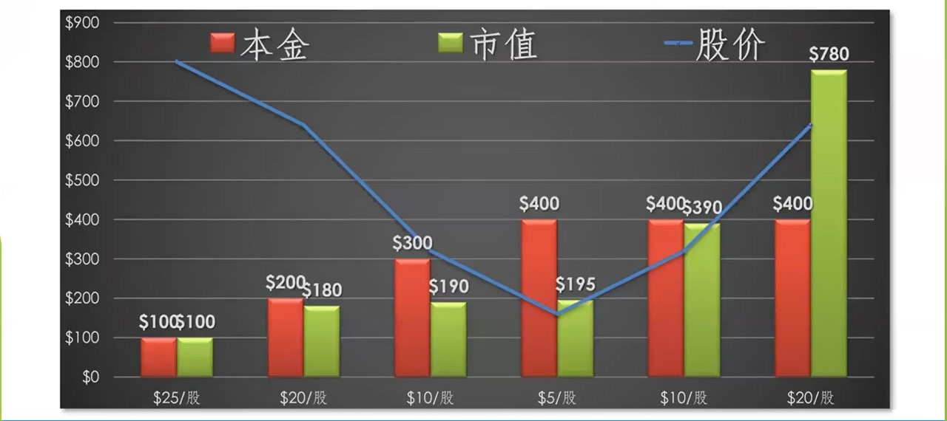
投资基本法则 – 定投

Slide 70
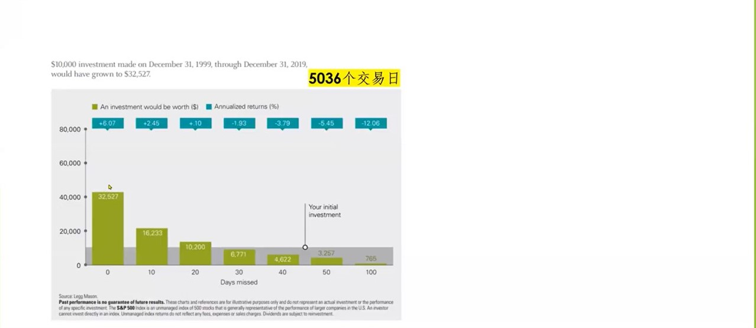
投资基本法则 –长期

Slide 71
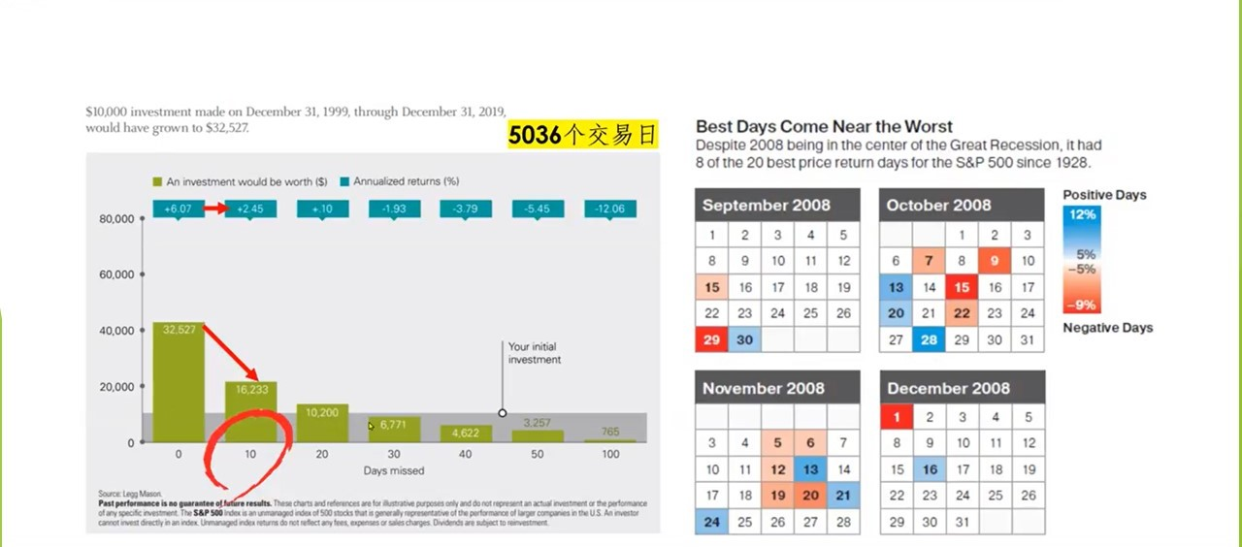
投资基本法则 – 长期

Slide 72
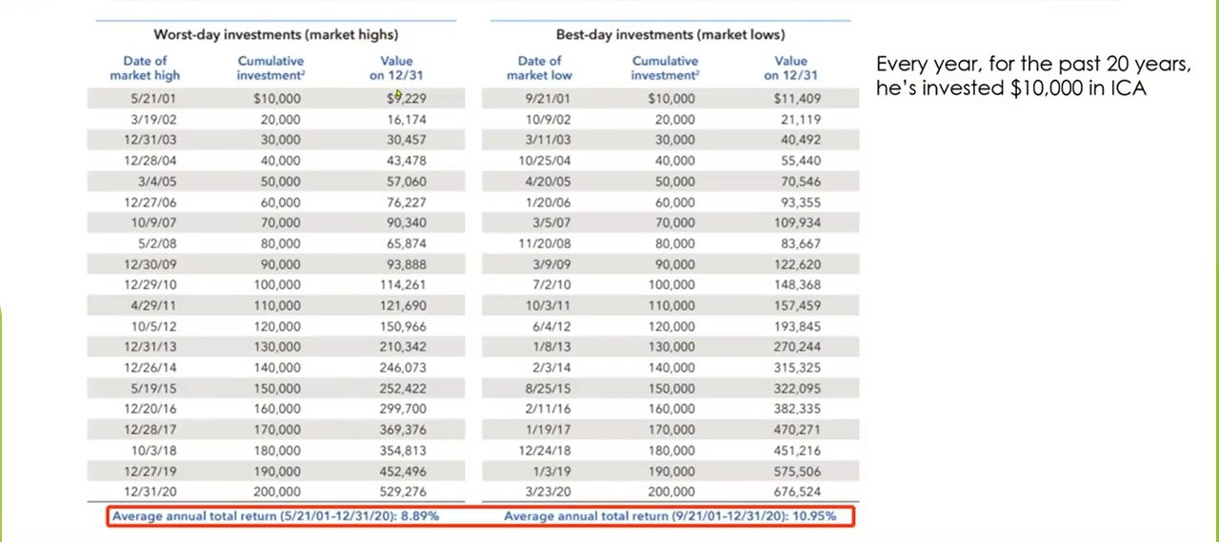
投资基本法则 – 长期

Slide 73
投资基本法则 – 长期
Date | Action | Symbol | Quantity | Price | Amount
4/3/2025 | Buy | BAC | 500 | $37.18 | ($18,587.50)
4/4/2025 | Buy | BAC | 1,000 | $34.50 | ($34,497.64)
4/8/2025 | Buy | BAC | 500 | $34.42 | ($17,210.00)
4/8/2025 | Buy | BAC | 500 | $35.65 | ($17,823.00)
4/8/2025 | Sell | BAC | 1,000 | $36.86 | $36,853.81
4/9/2025 | Sell | BAC | 499 | $37.38 | $18,649.53
4/9/2025 | Sell | BAC | 1 | $37.42 | $37.42
4/9/2025 | Sell | BAC | 500 | $37.19 | $18,594.40
4/9/2025 | Sell | BAC | 500 | $36.27 | $18,131.92
4/9/2025 | Buy | BAC | 500 | $33.45 | ($16,722.50)
4/10/2025 | Sell | BAC | 500 | $35.71 | $17,854.66
4/10/2025 | Sell | BAC | 500 | $35.24 | $17,619.48
4/10/2025 | Buy | BAC | 500 | $34.78 | ($17,387.50)
4/10/2025 | Buy | BAC | 500 | $35.10 | ($17,549.05)
4/10/2025 | Buy | BAC | 500 | $35.60 | ($17,798.97)
4/14/2025 | Sell | BAC | 500 | $36.78 | $18,389.41
4/15/2025 | Sell | BAC | 500 | $38.35 | $19,174.39
4/16/2025 | Buy | BAC | 500 | $37.00 | ($18,500.00)
4/16/2025 | Buy | BAC | 500 | $37.33 | ($18,664.95)
4/17/2025 | Sell | BAC | 500 | $37.75 | $18,876.20
4/21/2025 | Buy | BAC | 500 | $36.86 | ($18,428.15)
4/22/2025 | Sell | BAC | 500 | $38.12 | $19,060.84
4/22/2025 | Sell | BAC | 500 | $37.94 | $18,966.89
Total |  |  |  |  | $9,039.00
 |  |  |  | 87130 | 10.37%

Slide 74
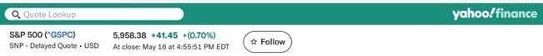
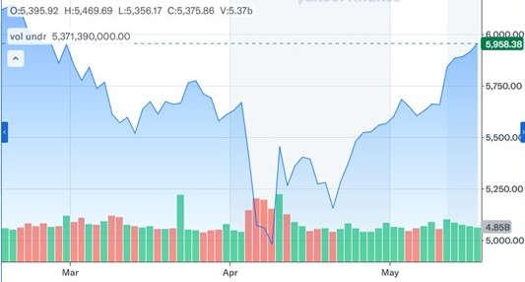
投资基本法则 – 长期

Slide 75
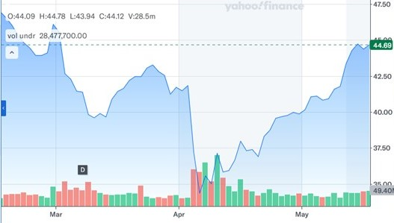
投资基本法则 – 长期

Slide 76
退休计划的五个投资基本法则
早投 （Invest earlier）--- by compounding rules， 尽可能多投
分散 （Diversification）
定投 （Dollar cost averaging) --- not timing the market
长期 （Time in the market not timing the market）--- 不随市场变化reallocate
保本 （Downside protection）

Slide 77
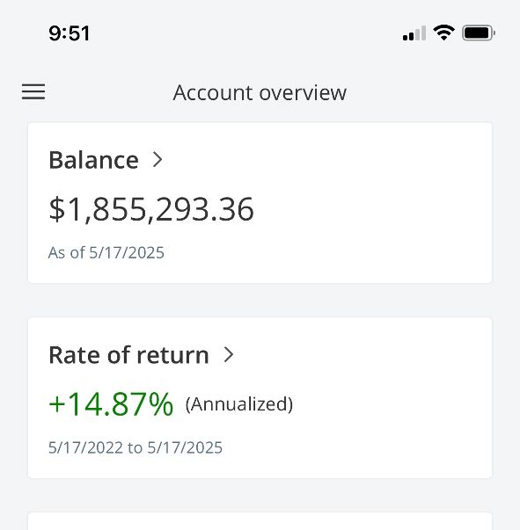
我们的退休计划
Started from June 2004
To 2012, invested full amount allowed + employer match
From 2012 to 2023, invested $15,000 annually + employer match

Slide 78
我们的退休计划
Formula:
P = d * ((1 + r/k)^(Nk) - 1) / (r/k)
Where: P = Final balance after N years, d = Regular contribution (annual), r = Annual interest rate, k = Number of compounding periods per year, and N = Number of years.

Slide 79
我们的退休计划
Example：
Let's say you contribute $5,000 annually, expect an 8% annual return, and plan to invest for 20 years. Assuming annual compounding (k=1):
P = 5000 * ((1 + 0.08)^20 - 1) / 0.08
P ≈ $327,331.70

Slide 80
我们的退休计划
https://www.fidelitybanker.com/calculator/retire-401k

Slide 81
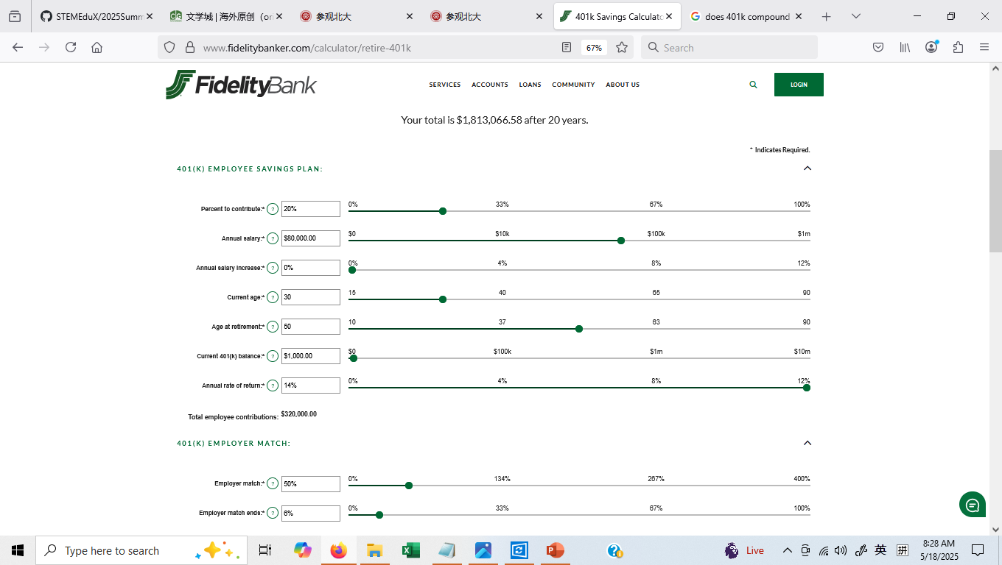
我们的退休计划

Slide 82
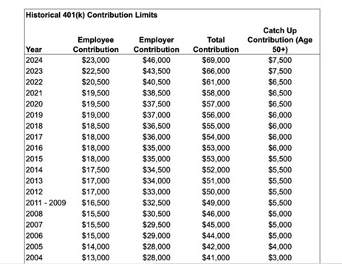
我们的退休计划

Slide 83
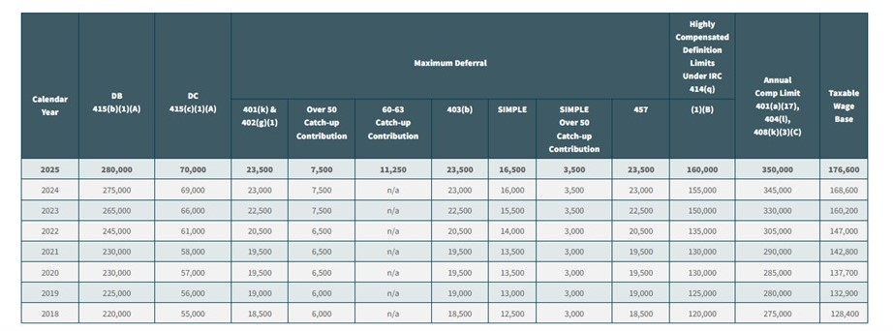
我们的退休计划

Slide 84
我们的退休计划
Started from June 2004
To 2012, invested full amount allowed + employer match
From 2012 to 2023, invested $15,000 annually + employer match

Slide 85
401K投资与家庭住房MORTGAGE投资的关系
401K投资与股票投资的关系
401K投资与其它如房地产投资的关系
小企业，餐馆，个人企业LLC如何制定退休计划

Slide 86

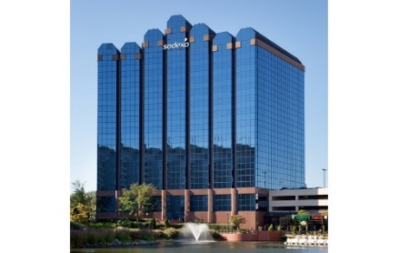

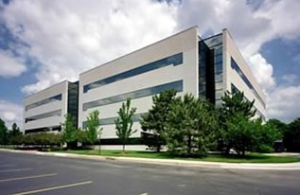
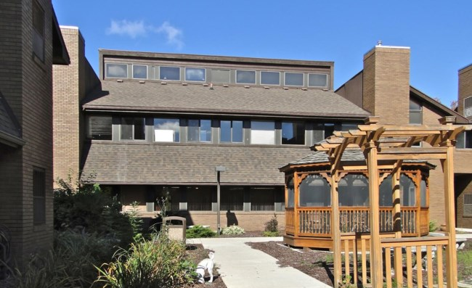
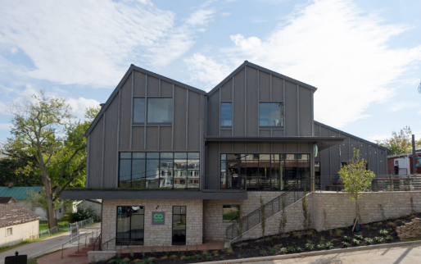

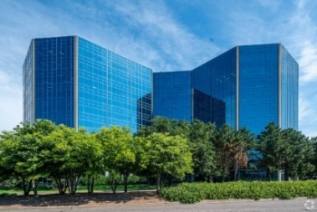
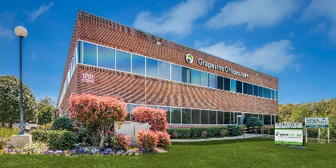

我们的办公室
哥伦比亚 ，马里兰
盖城，马里兰
泰森，弗吉尼亚
底特律，密歇根
兰辛，密歇根
都柏林，俄亥俄
尔湾，加州
明尼唐卡，明尼苏达
达拉斯，德州
迈阿密，佛罗里达

Slide 87
您的三大福利
1. 免费家庭全盘财务和税务规划分析
理清财务状况，发现规划盲区
从六个方面（风险控制，税务规划，家庭保护，子女教育，退休养老，财富传承）给出具体建议
2. 注册成我们的学员（$125注册费）
终身免费的财商教育，分享理财师内部资料，系统的学习如何做好家庭财务规划
终身免费财务咨询，共享团队理财师，税务师，律师资源
需要实名注册，无犯罪破产记录
3. 加入北极星团队
世界500强金融服务平台支持，全牌照，独立理财师支持
时间投入灵活，可兼职开始
共同普及财商知识，服务广大中产阶级

Slide 88
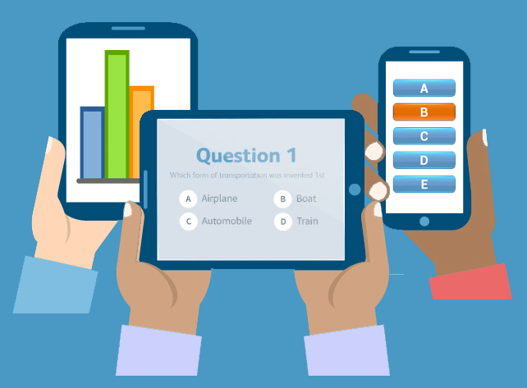
Q&A?

